Slide 1
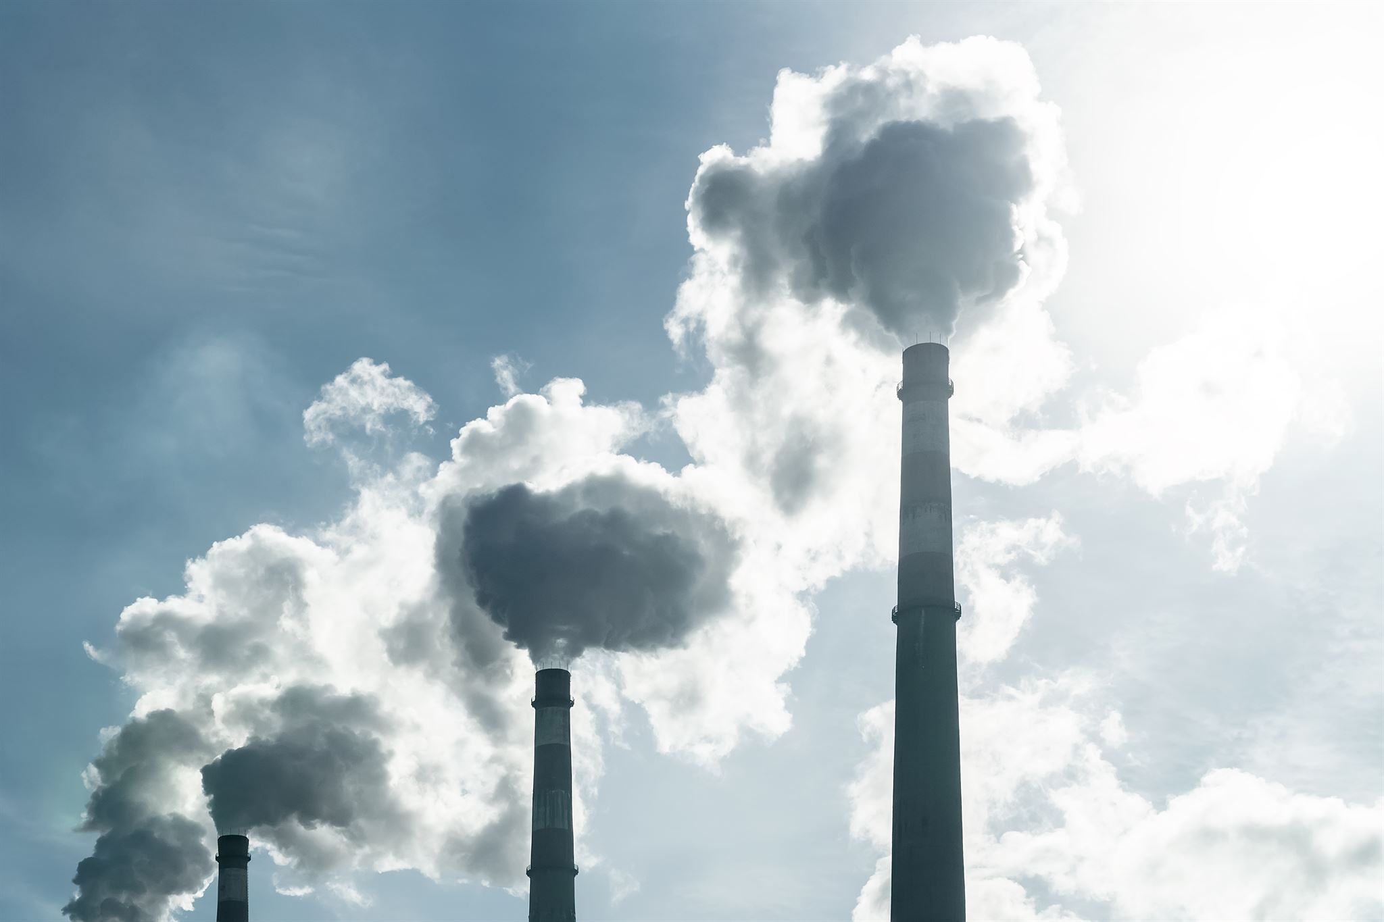
Exploring CO2 Emissions
David Perez
CAP 4744: Data Visualizations
October 14, 2024

Slide 2








Presentation Overview
This is an exploratory analysis of eight countries (Australia, Brazil, Canada, China, India, South Africa, United States of America, and Germany) regarding CO2 emissions spanning from the years 2000-2022.
We will be looking at the amount of CO2 emissions emitted by the people living in these countries as well as CO2 emissions emitted by specific sectors and industries.
Furthermore, we will explore possible correlations between CO2 emissions and sectoral GDP, urbanization, industrial growth, transportation growth, energy consumption, and renewable energy usage.

Slide 3

CO2 Background
What are CO2 Emissions?
CO2 emissions are the release of carbon dioxide from human activities such as transportation, industry, and energy production, released into the atmosphere, contributing significantly to global warming and climate change.
What are the primary sources of CO2 emissions?
CO2 emissions primarily arise from burning fossil fuels like coal, oil, and natural gas for energy.
Why is this significant?
CO2 emissions have detrimental impacts on climate change, leading to extreme weather events, rising sea levels, and ecological disruptions. Understanding CO2 emissions is vital for addressing climate change, which affects ecosystems and human health worldwide. Monitoring CO2 emissions is crucial for environmental protection and addressing climate change challenges.

Slide 4
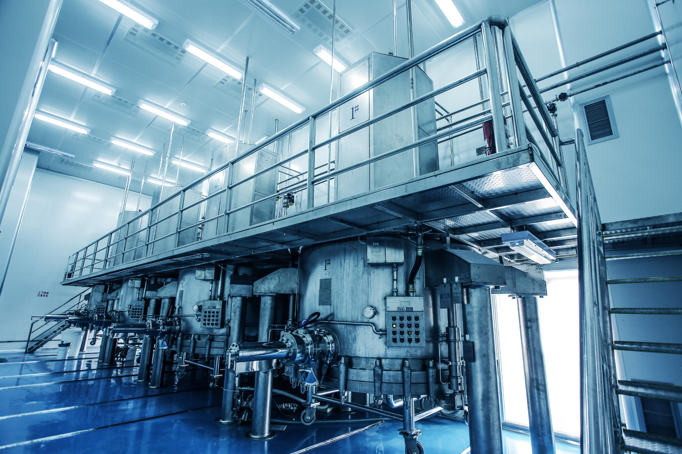
Sector/Industry Background
The sectors we will be evaluating regarding CO2 emissions are the Automobile, Industrial, Agriculture, Domestic, and Miscellaneous sectors. The data collected is based on individually recorded instances pertaining to each of these sectors, meaning every time a CO2 emission measurement was taken at a CO2 emitting site, the event was recorded and placed into this dataset with all applicable relevant information.
The Miscellaneous sector refers to a combination of uncategorized CO2 emission instances that were not applicable to the Automobile, Industrial, Agriculture, or Domestic sectors. Miscellaneous CO2 emissions include but are not limited to the following: treatment and disposal of waste, commercial activities, and public services.
Industries within these sectors include the Construction, Energy, Manufacturing, and Mining industries.

Slide 5

Other Categorical Background
The GDP for this analysis is based on Sectoral GDP, meaning the GDP of a country that is specific to these particular CO2 emitting sectors/industries.
Energy consumption is measured in terawatt-hours, or TWh (a unit of energy that represents one trillion watt-hours), and CO2 emissions are measured in metric tons.
The Urbanization Percentage is the percentage of urbanized areas within a country.
The Renewable Energy Percentage is the percentage of renewable energy utilized by a country.
The Industrial Growth Percentage is the percentage of industrial growth a country has had from 2000-2022.
The Transport Growth Percentage is the percentage of transportation growth a country has experienced from 2000-2022.

Slide 6

Presentation Content
The countries with the least and most CO2 emissions
The amount of CO2 the average person emits
The year with the least and most CO2 emissions
The sector with the least and most CO2 emissions
The industry with the least and most CO2 emissions
Correlations between CO2 emissions and urbanization, sectoral GDP, industrial growth, transportation growth, renewable energy usage, and energy consumption.

Slide 7
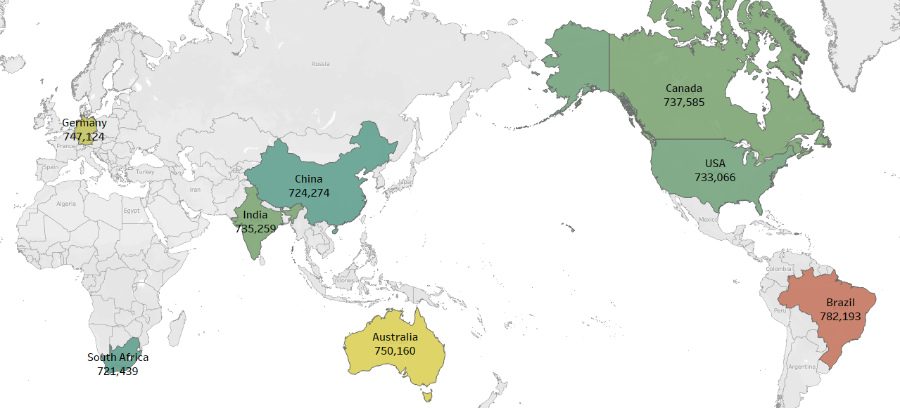
Which country produced the most amount of CO2 emissions? The least?
Brazil created the most CO2 emissions at 782,193 metric tons while South Africa created the least amount of CO2 emissions at 721,439 metric tons.

Slide 8


Which country produced the most CO2 emissions on average? The least?
Although Brazil has the most overall CO2 emissions, the US emits the most CO2 emissions on average at 338.44 metric tons per instance. South Africa is the country that contributed the least amount of CO2 emissions on average at 332.46 metric tons per instance.

Slide 9

How much CO2 emissions does the average person produce?
The average person emitted 1.8 metric tons of CO2 emissions. Brazil averaged the most CO2 emissions per person at 2.6 metric tons while India produced the least amount of CO2 emissions per person at 1.4 metric tons.

Slide 10

In what year were the most CO2 emissions produced?
The year 2022 emitted the most CO2 emissions at 279,407 metric tons. The year 2013 produced the least amount of CO2 emissions at 241,439 metric tons.

Slide 11
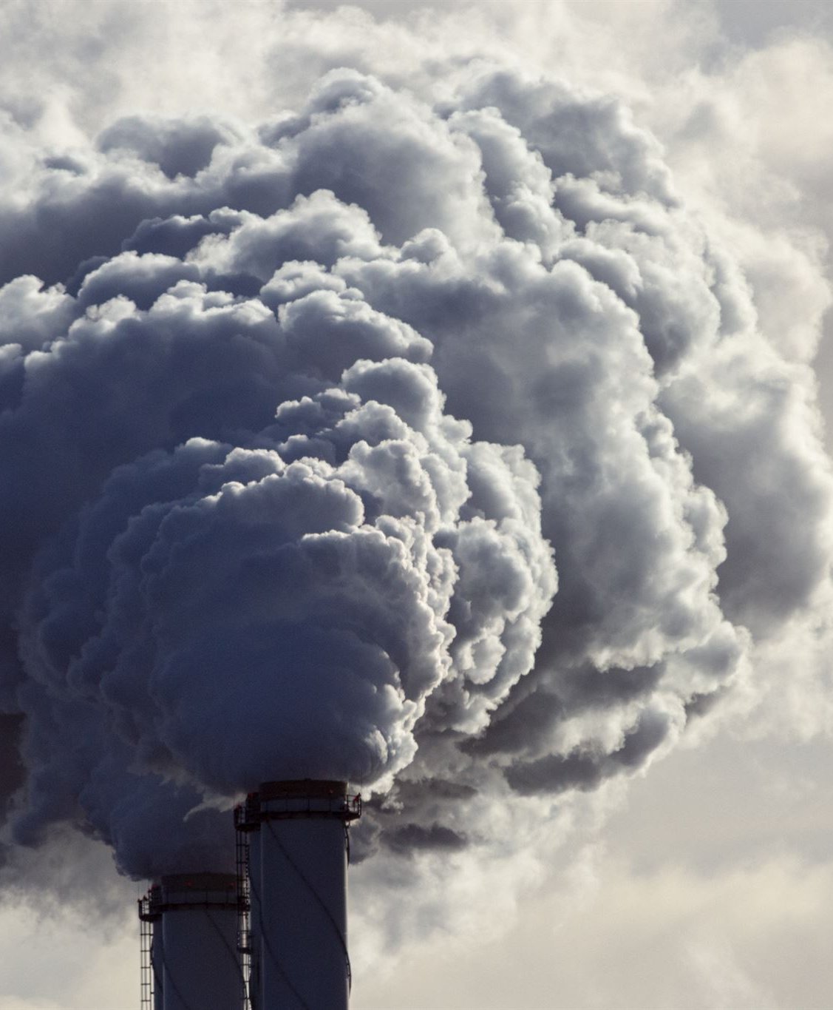
Which sector produced the most CO2 emissions? The least?
Miscellaneous CO2 emissions (such as treatment and disposal of waste, commercial activities, and public services) emitted the most CO2 emissions by sector overall (2,658,766 metric tons) and on average (115,599 metric tons a year). Domestic CO2 emissions emitted the least CO2 emissions by sector overall (179,867 metric tons) and on average (7,820 metric tons a year).

Slide 12
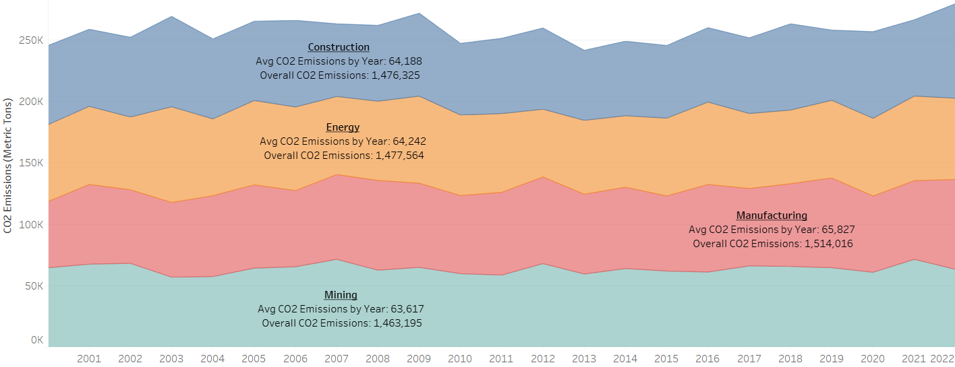
Which industry produced the most CO2 emissions? The least?
The Manufacturing industry creates the most CO2 emissions overall (1,514,016 metric tons) and on average (65,827 metric tons). The Mining industry creates the least amount of CO2 emissions overall (1,463,195 metric tons) and on average (63,617 metric tons).

Slide 13

Do countries with higher urbanization percentages tend to produce more CO2 emissions?
Countries that produce a higher amount of CO2 emissions tend to have a lower urbanization percentage.

Slide 14

Do countries with a higher Sectoral GDP create more CO2 emissions?
Countries with a higher Sectoral GDP tend to produce less CO2 emissions.

Slide 15

Do countries with high CO2 emissions tend to have a high industrial growth percentage?
Countries that produce a high amount of CO2 emissions tend to have a lower industrial growth percentage.

Slide 16

Do countries with a high amount of CO2 emissions tend to have a high transport growth percentage?
Countries with a high amount of CO2 emissions tend to have a high transport growth percentage as well.

Slide 17

Do countries with an increasing amount of renewable energy use produce a lot of CO2 emissions?
Countries with a higher Renewable Energy percentage tend to have higher CO2 emissions.

Slide 18

Does energy consumption equate to higher CO2 emissions?
Countries that have a high energy consumption rate tend to produce more CO2 emissions.

Slide 19

Summary
Between 2000-2022, the average person from these eight countries emitted 1.8 metric tons of CO2, contributing to a total of 5,913,101 metric tons of CO2.
Brazil (overall) and The United States (on average) seem to be the major contributors of CO2 emissions.
South Africa seems to contribute the least amount of CO2 emissions (overall and on average).
Miscellaneous CO2 emissions is the sector that contributes the most CO2 emissions (overall and on average).
Domestic CO2 emissions have contributed the least amount of CO2 emissions (overall and on average).
The Manufacturing (overall) and Construction (on average) industries contribute the most CO2 emissions.
The Mining industry contributes the least amount of CO2 emissions (overall and on average).

Slide 20
Summary (continued)
There does not seem to be a trend when it comes to CO2 emissions over the years as the numbers tend to fluctuate in this regard.
There is a downward trend when it comes to the amount of CO2 emissions a country has and the average sectoral GDP.
There seems to be a slight negative correlation between the amount of CO2 emissions a country produces and their average Industrial Growth Percentage.
There is an upward trend when it comes to the amount of CO2 emissions a country produces and a country’s average Transport Growth Percentage.
There is a negative correlation between the amount of CO2 emissions a country has produced and their average Urbanization Percentage.
There is an upward trend when it comes to the amount of CO2 emissions a country produces and a country’s average Renewable Energy Percentage.
Overall, we can assume that more CO2 emissions are a result of more Energy Consumption.

Slide 21

Further Analysis
I would like to get more data from previous years to do an overall assessment of CO2 emissions.
I would like to get detailed information about what other sectors make up the Miscellaneous CO2 emissions attribute. I feel like we can get even more granularity as to what sectors are causing high levels of CO2 emissions.
I would also like to have some type of climate temperature measurements for each country to compare the CO2 emissions.
I would like to have some natural disaster data to compare CO2 emissions.
I would like to have every country’s CO2 emissions information.
More data on deforestation to see the influence of CO2 emissions.

